Slide 1

eBook
A web MVC project for PeopleCERT Coding Bootcamp
Andreas Koutroulis: Front End / DB Petros Foutsis: Back End / DB

Slide 2
Technologies and packages used:
Sails v1
My-SQL (sails-mysql)
SASS
bcryptjs
Paypal-Checkout
Socket.io

Slide 3
Description
eBook is a web app where the user can search for the next eΒook he wants to travel with. He can filter the search results by title, genre, price and whether or not the eBook is Best Seller or Editor’s Choice.
Once the user sign up, he can purchase an eBook and read it. At anytime he can visit his account and check the eBooks he owns. If you’re not sure what to pick next, ask another member at the chat!
The admin has full CRUD functionality at eBook model, so be aware for new entries… Αlso be polite at the chat because the admin can delete a user’s account.

Slide 4
The app has three user roles
Guest
Homepage
eBook search
Member
Buy eBook
Read eBook
Admin
CRUD functionality for eBooks
FAQ
eBook details & description
Edit & Update personal info
Chat
Delete users account

Slide 5
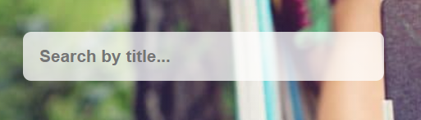

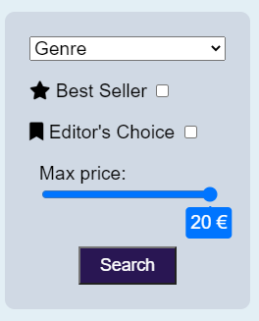
How to use eBook - 1
Homepage
Browse genres
Best Sellers
Editor’s Choice
/ebook (search)
Search by title
Search box

Slide 6
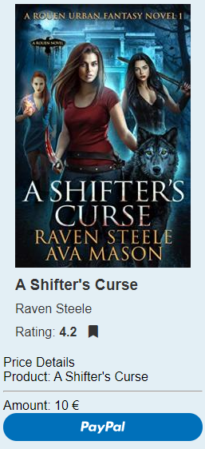
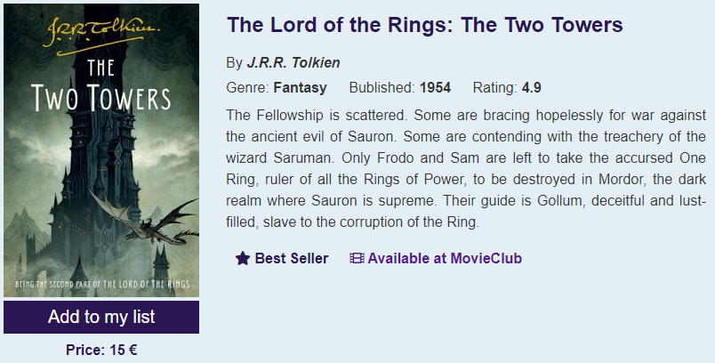
How to use eBook - 2
/title/:id
eBook details
Description
Availability at MovieClub
Add to my list button
/payment/:id
Total price
PayPal button

Slide 7
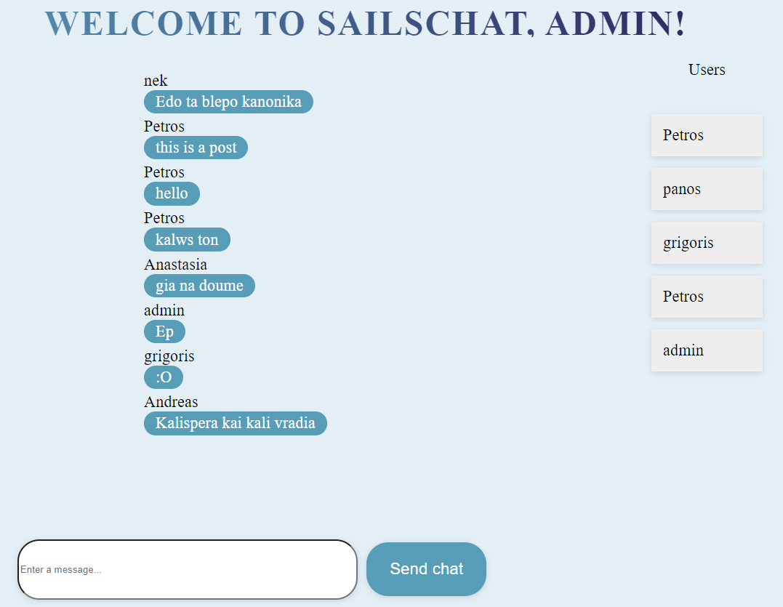
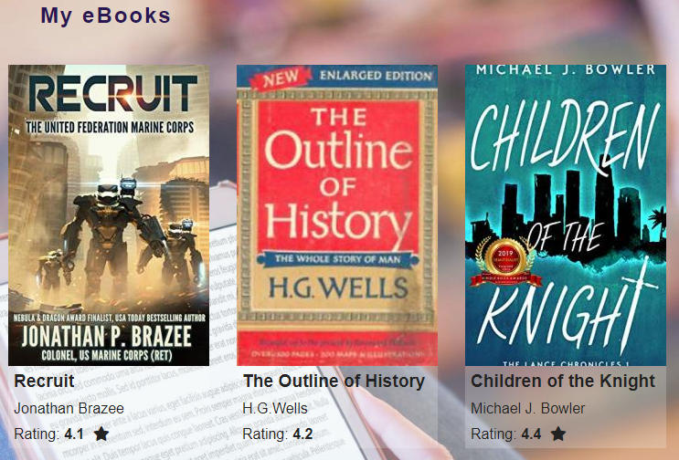
How to use eBook - 2
/account
/chat
Chat with other members
/myebooks

Slide 8
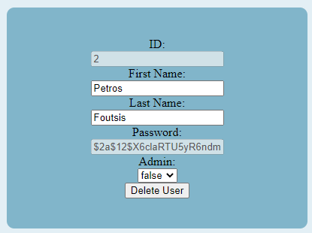
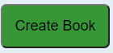
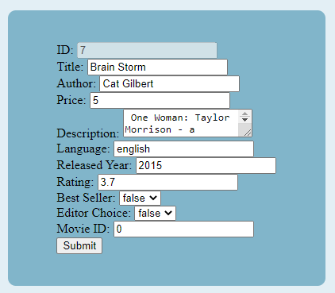
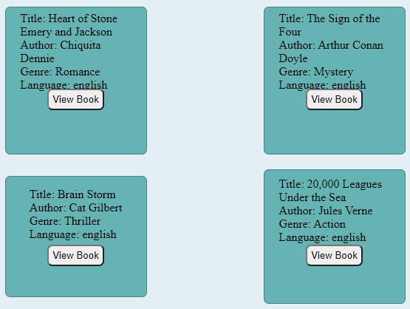
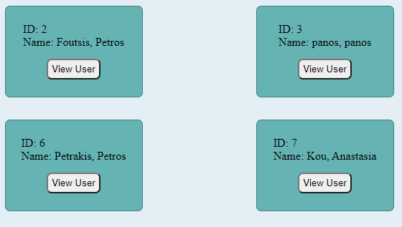
How to use eBook - 3
Log in as admin
Username: admin@admin.com
Password: Admin1234

